Slide 1
Market Prediction (Machine Learning) Deepika under the guidance of Mentorness

Slide 2
Background
In the realm of market analysis and forecasting, understanding the intricate patterns within time series data is paramount for informed decision-making. With the advent of machine learning techniques, it's now possible to delve deeper into historical market data to predict future trends accurately. In this context, we have at our disposal a dataset containing monthly market data spanning multiple years, encompassing various regions, commodities, and pricing information.

Slide 3
Objective
The primary objective of this project is to develop a robust time series machine learning model capable of accurately forecasting market trends based on historical data. By leveraging advanced algorithms, we aim to predict the quantity and prices of commodities for future months, empowering stakeholders to make proactive decisions regarding production, procurement, pricing strategies, and resource allocation.

Slide 4
Data Description
The dataset comprises the following columns:
market: The market or commodity under consideration.
month: The month for which the data is recorded.
year: The year corresponding to the recorded data.
quantity: The quantity of the commodity traded or available.
priceMin: The minimum price of the commodity during the month.
priceMax: The maximum price of the commodity during the month.
priceMod: The mode or most frequently occurring price of the commodity during the month.
state: The state or region where the market is located.
city: The city where the market is situated.
date: The specific date of the recorded data

Slide 5

Analysis of Data Set

Slide 6
1.Data Preprocessing: Cleaning the dataset, handling missing values, and encoding categorical variables.
2. Exploratory Data Analysis (EDA): Analyzing the temporal patterns, identifying seasonality, trends, and anomalies within the data.
3. Feature Engineering: Creating relevant features such as lagged variables, rolling statistics, and seasonal indicators.
4. Model Selection and Training: Evaluating various time series forecasting models such as ARIMA, SARIMA, Prophet, and LSTM, selecting the most suitable one, and training it on the dataset.
5. Model Evaluation: Assessing the model's performance using appropriate metrics such as Mean Absolute Error (MAE), Mean Squared Error (MSE), and Root Mean Squared Error (RMSE).
6. Fine-tuning and Validation: Fine-tuning the model parameters, validating its performance on unseen data, and iterating if necessary.

Slide 7
Data Preprocessing
In machine learning, data preprocessing is a set of procedures and methods used to prepare unprocessed data so that machine learning models can be trained on it. The effectiveness of the models is directly impacted by the relevance and quality of the data, which makes this step essential.

Slide 8
Exploratory Data Analysis (EDA)
An essential step in the data analysis process is called exploratory data analysis (EDA), during which analysts employ a variety of strategies, frequently visual ones, to identify the key features of the data. Using summary statistics and graphical representations, exploratory data analysis (EDA) aims to provide insights into the data set, reveal underlying patterns, identify anomalies, test hypotheses, and verify assumptions.

Slide 9
Feature Engineering
A critical phase in the machine learning process is feature engineering, which entails generating, adjusting, or choosing the most pertinent features from unprocessed data in order to enhance the functionality of machine learning models. The objective is to convert unprocessed data into insightful inputs that can improve models' capacity for prediction.
.

Slide 10
Model Selection and Training
The process of selecting the best machine learning model for a job from a pool of candidate models is known as model selection. This is done by evaluating each model's performance using the available data. This stage is crucial since different models have varying assumptions, strengths, and weaknesses, and choosing the appropriate one can have a big impact on how well the final solution performs.

Slide 11
Model Evaluation
A critical stage in the machine learning process is model evaluation, which entails determining how well a model functions with data that has not yet been observed. Estimating the model's capacity for generalization and confirming that it functions well on fresh, real-world data are the main objectives of model evaluation.

Slide 12
Fine-tuning and Validation
Fine-tuning and validation are essential steps in the machine learning pipeline that aim to optimize model performance and ensure its reliability on unseen data.

Slide 13
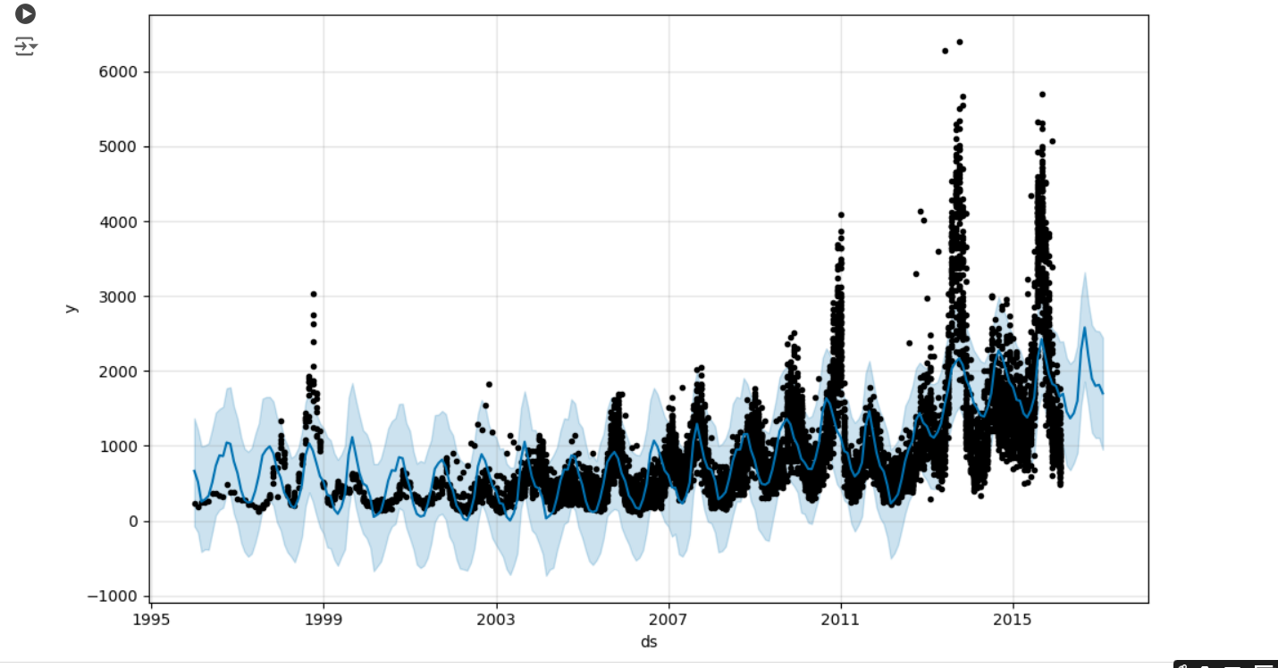
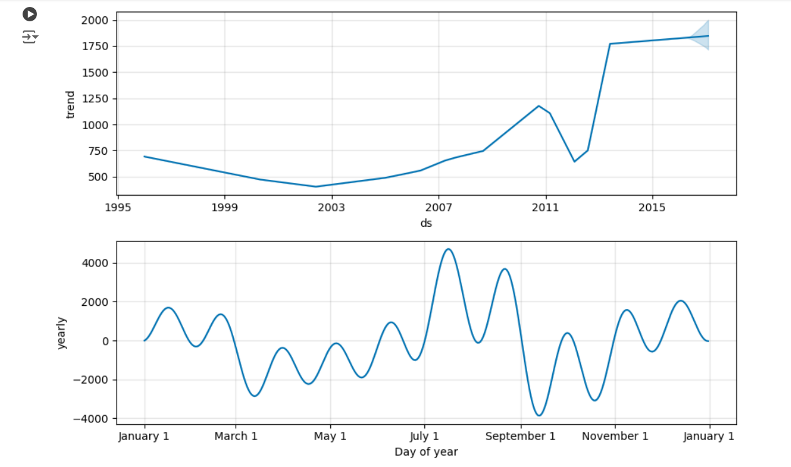
Trend depiction

Slide 14
Regression model performance is evaluated using common metrics, such as Mean Absolute Error (MAE), Mean Squared Error (MSE), and Root Mean Squared Error (RMSE), as you have said. When comparing the model's predictions to the actual values, each indicator offers a unique perspective on how reliable and accurate the model is.

Slide 15
Conclusion
In practical terms, these metrics help to evaluate how well your regression model is performing:
A lower MAE, MSE, or RMSE indicates better predictive accuracy.
MAE is easier to interpret and less sensitive to outliers than MSE and RMSE.
MSE and RMSE are more sensitive to outliers, which can be useful if larger errors are particularly problematic for your application.

Slide 16
Thank you

